Slide 1
INSTASMART APPLICATION
Name: Kushal Banik
EMP ID: 2157964
Email ID: Kushal.Banik2@cognizant.com
PHN: 7980859303
Front End Technology Used : ANGULAR JS

Slide 2
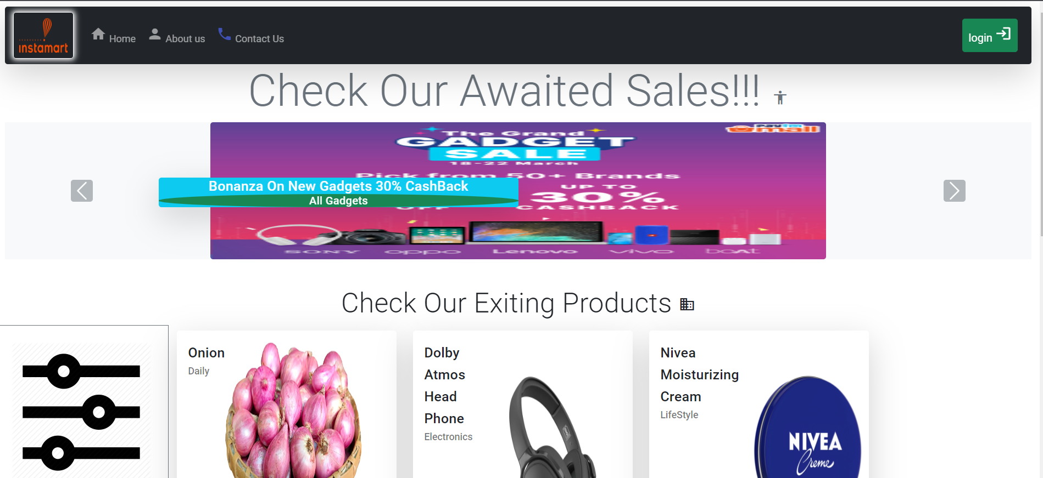
Home Page View Without Logged In (1)

Slide 3
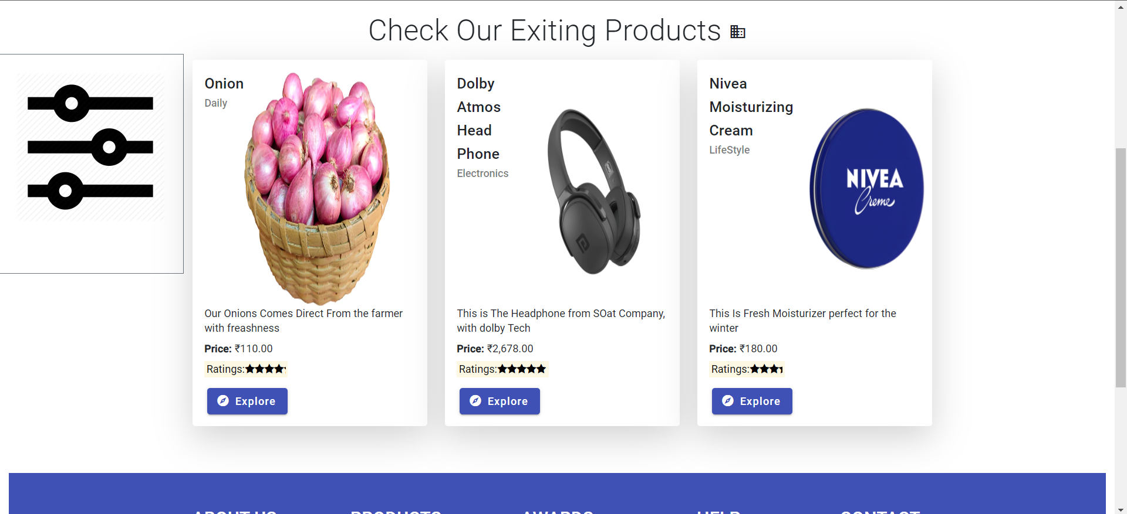
Home Page View Without Logged In (2)

Slide 4
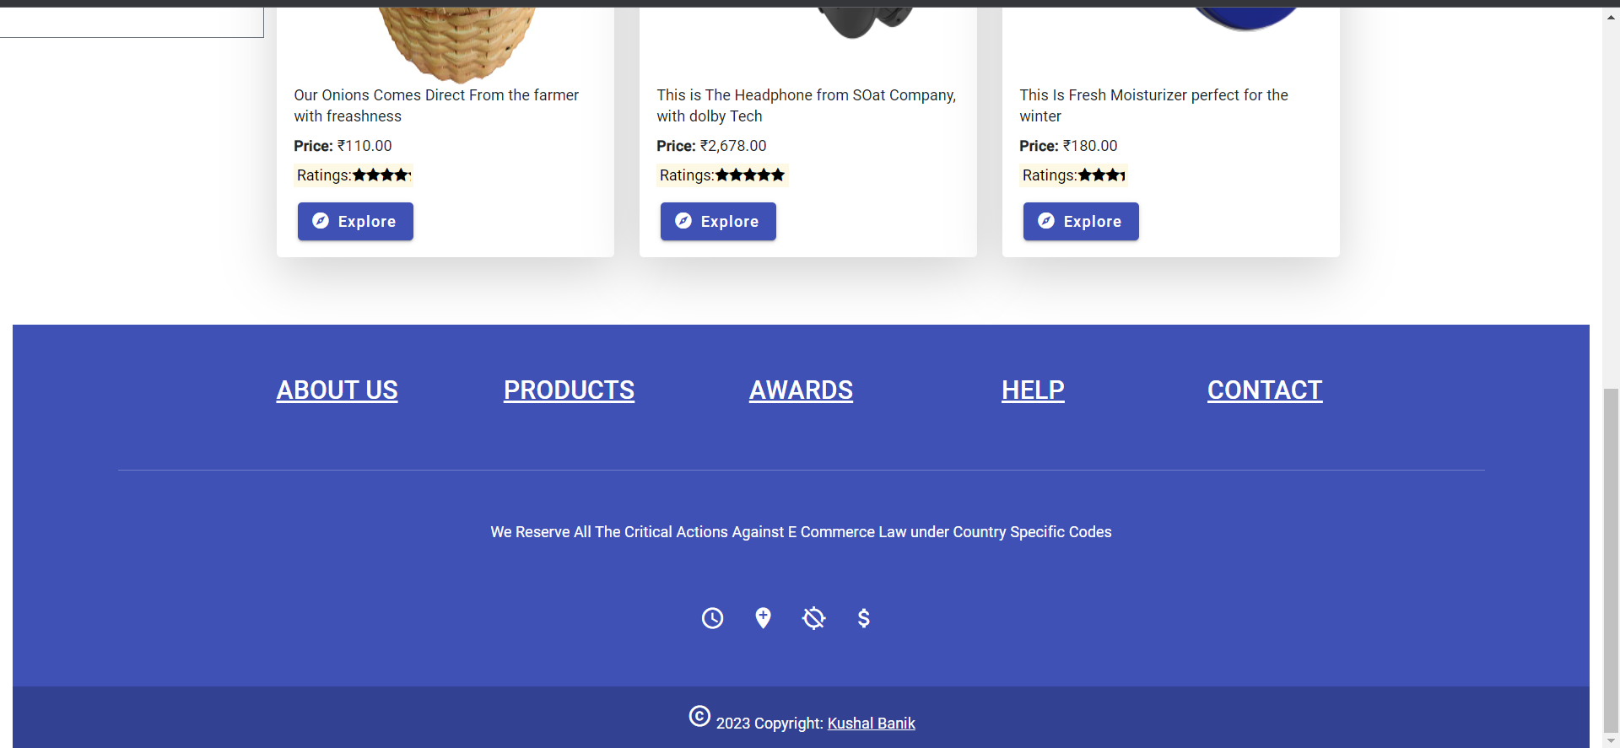
Home Page View Without Logged In (3)

Slide 5
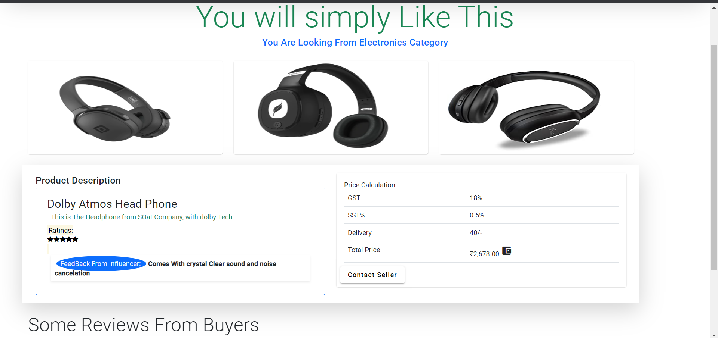
Specific Product Page Without Logged In

Slide 6
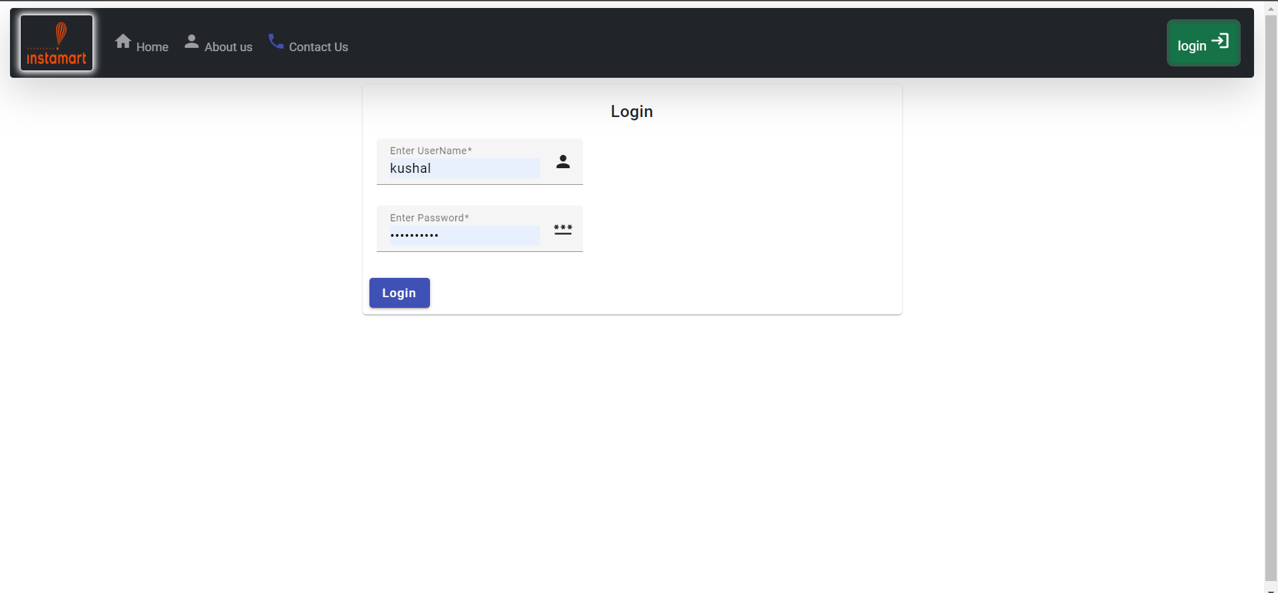
Login Page

Slide 7
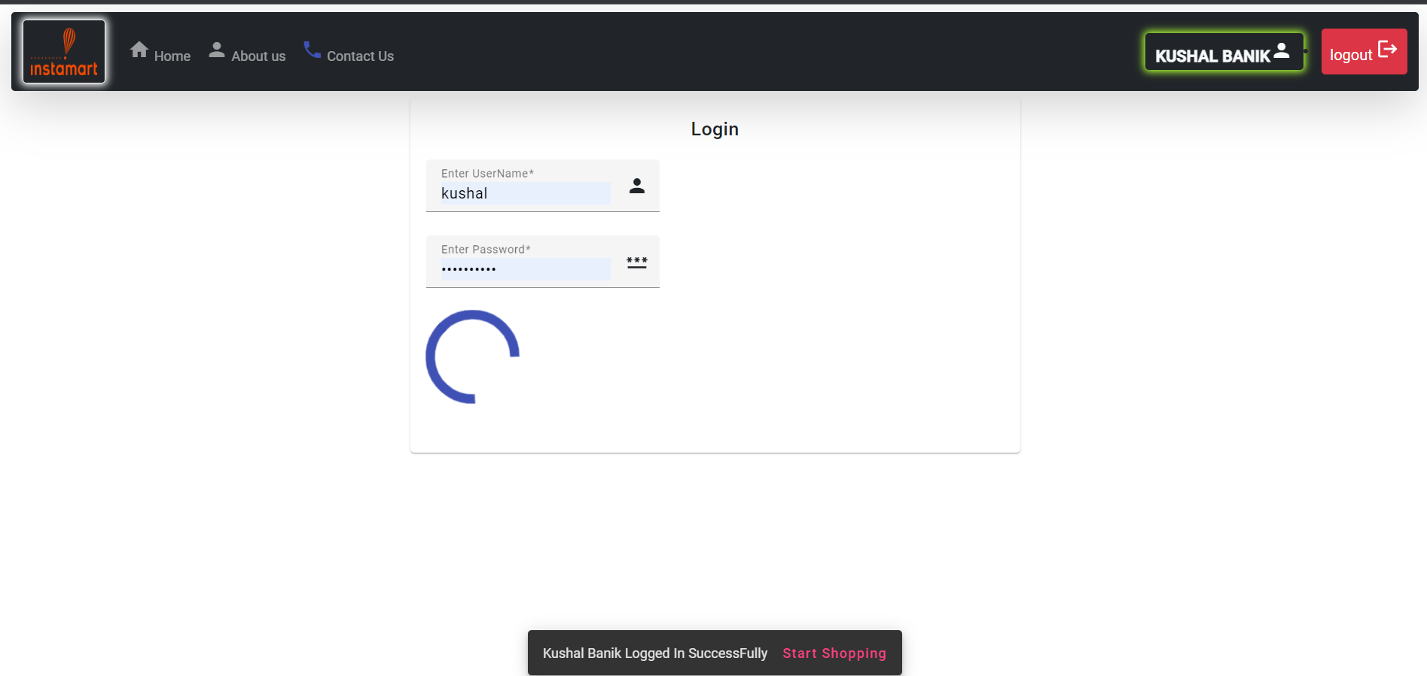
Logged In Successfully Page

Slide 8
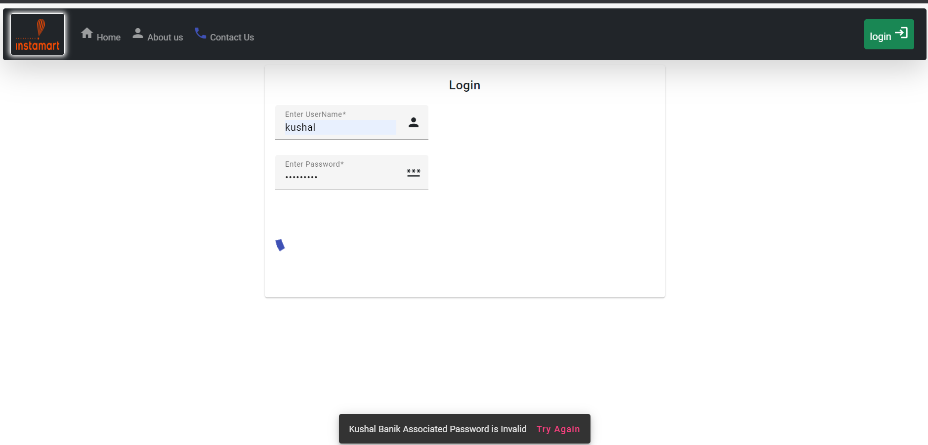
Logged In Failed Page

Slide 9

Home Page when Logged In As a Normal User (1)

Slide 10
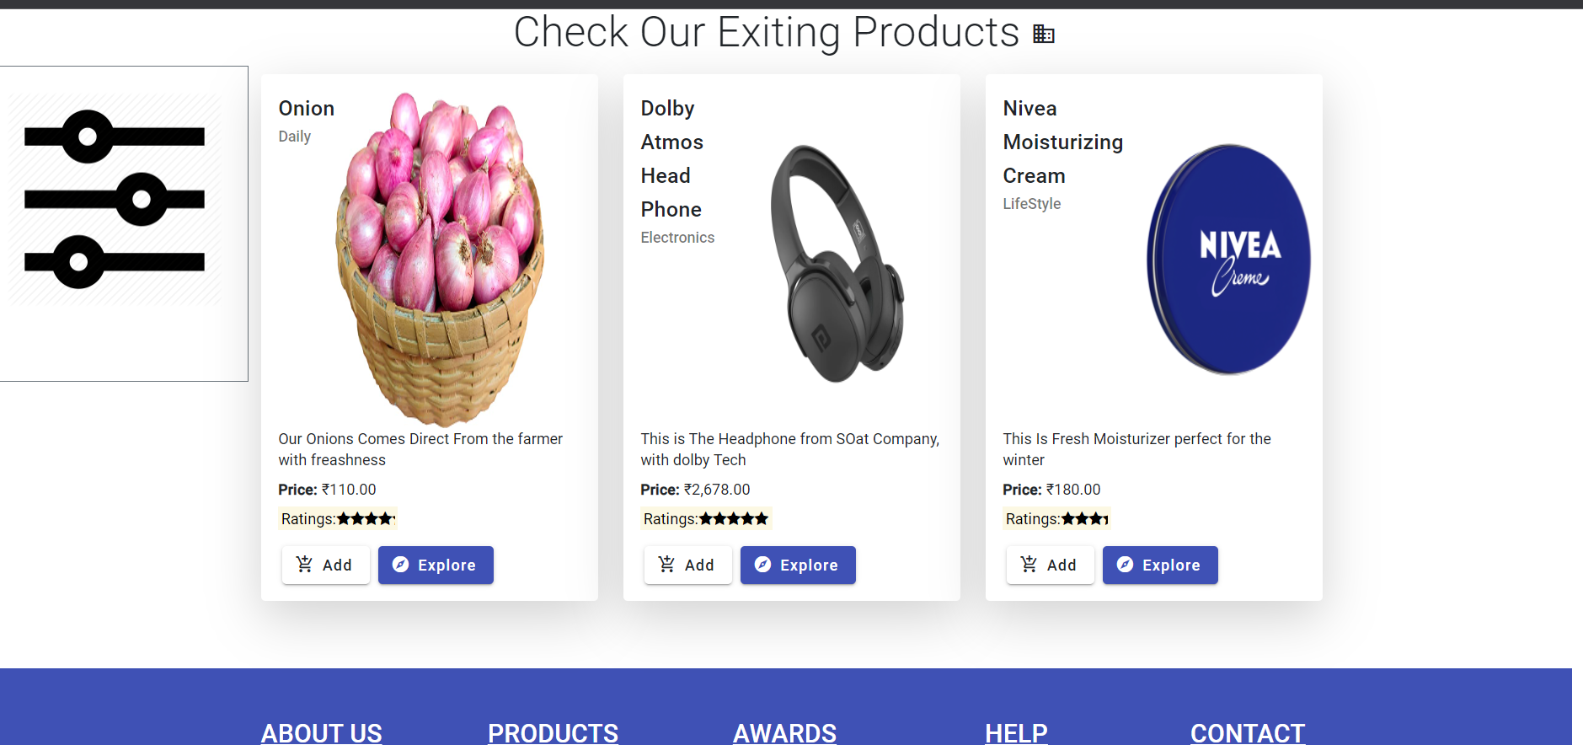
Home Page when Logged In As a Normal User (2)

Slide 11
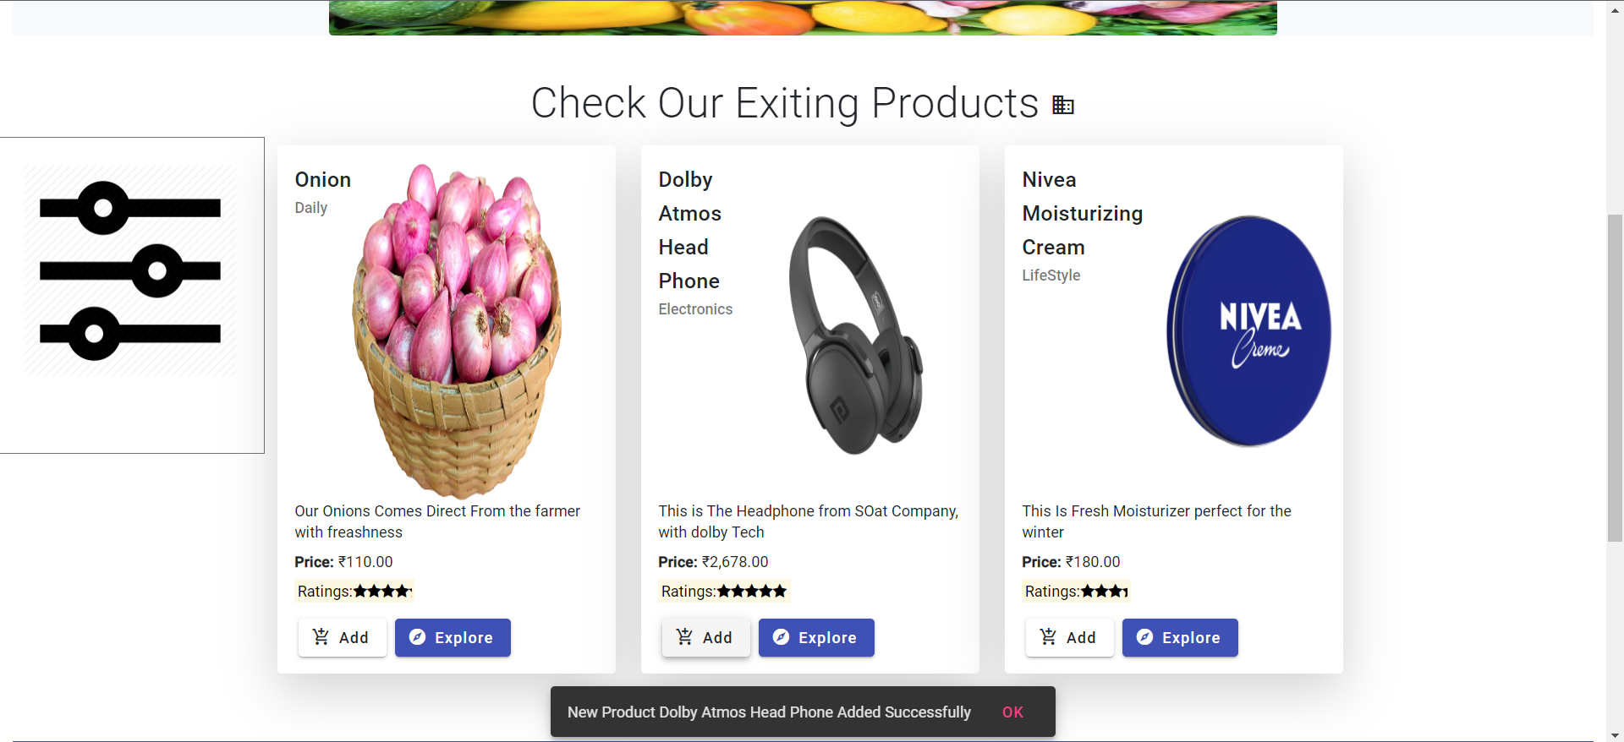
Adding Product To Cart As A User From Home Page

Slide 12
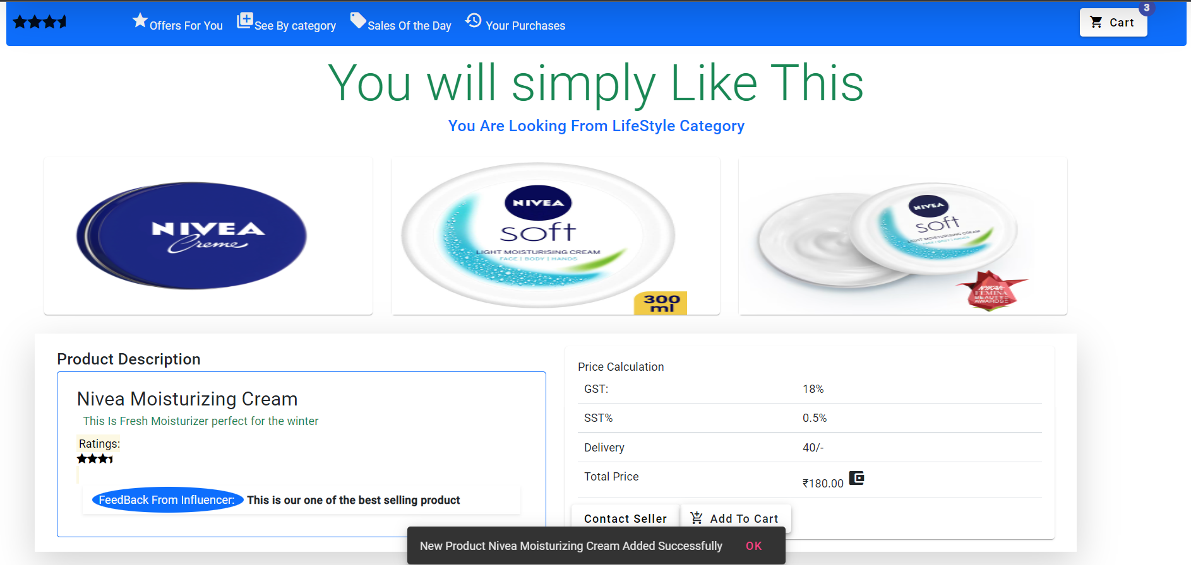
Adding Product To Cart As A User From Specific Product Page

Slide 13
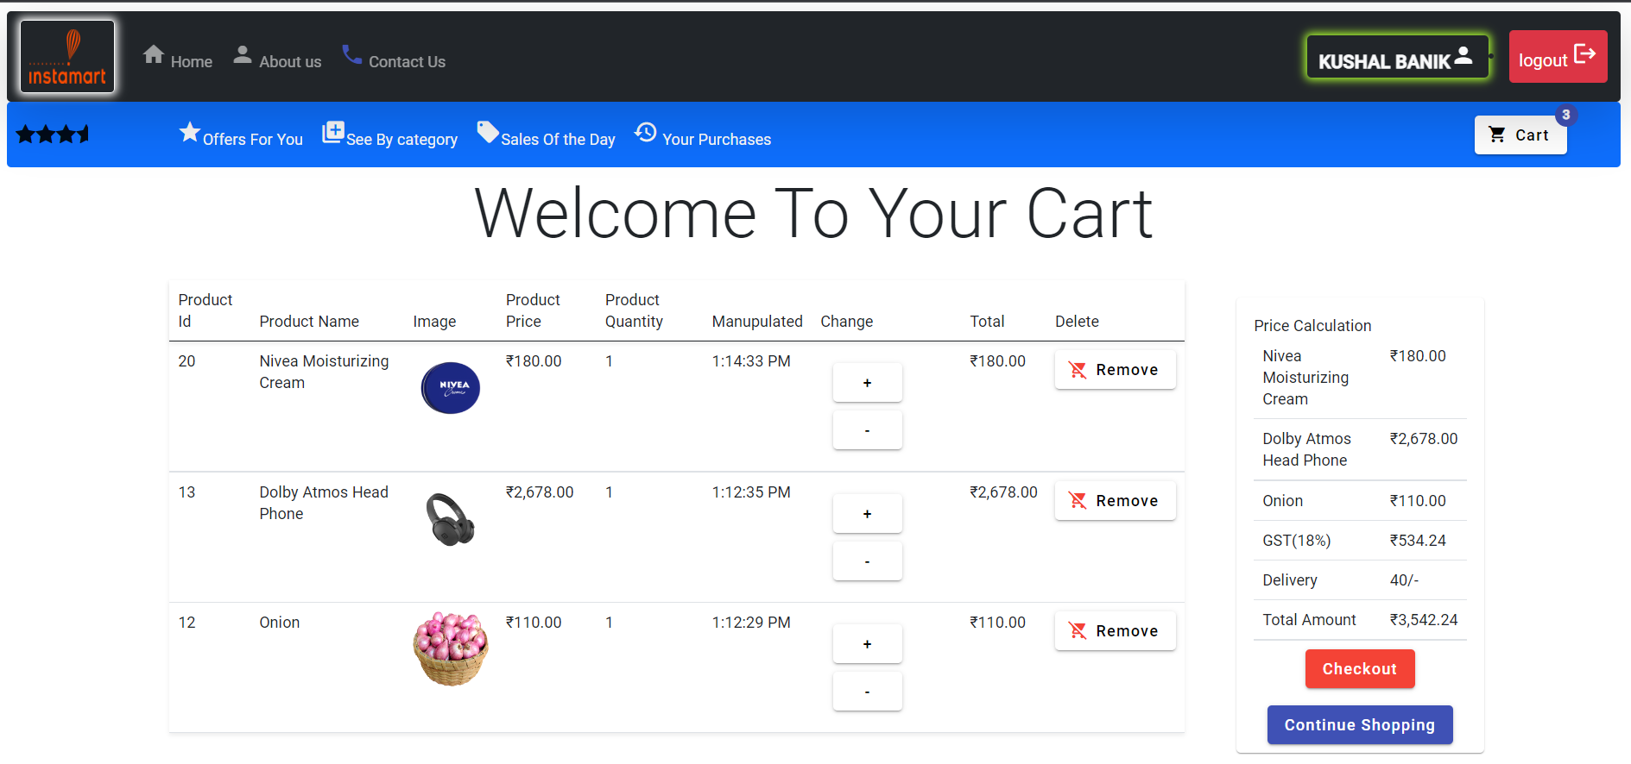
Cart View Page For Normal User

Slide 14
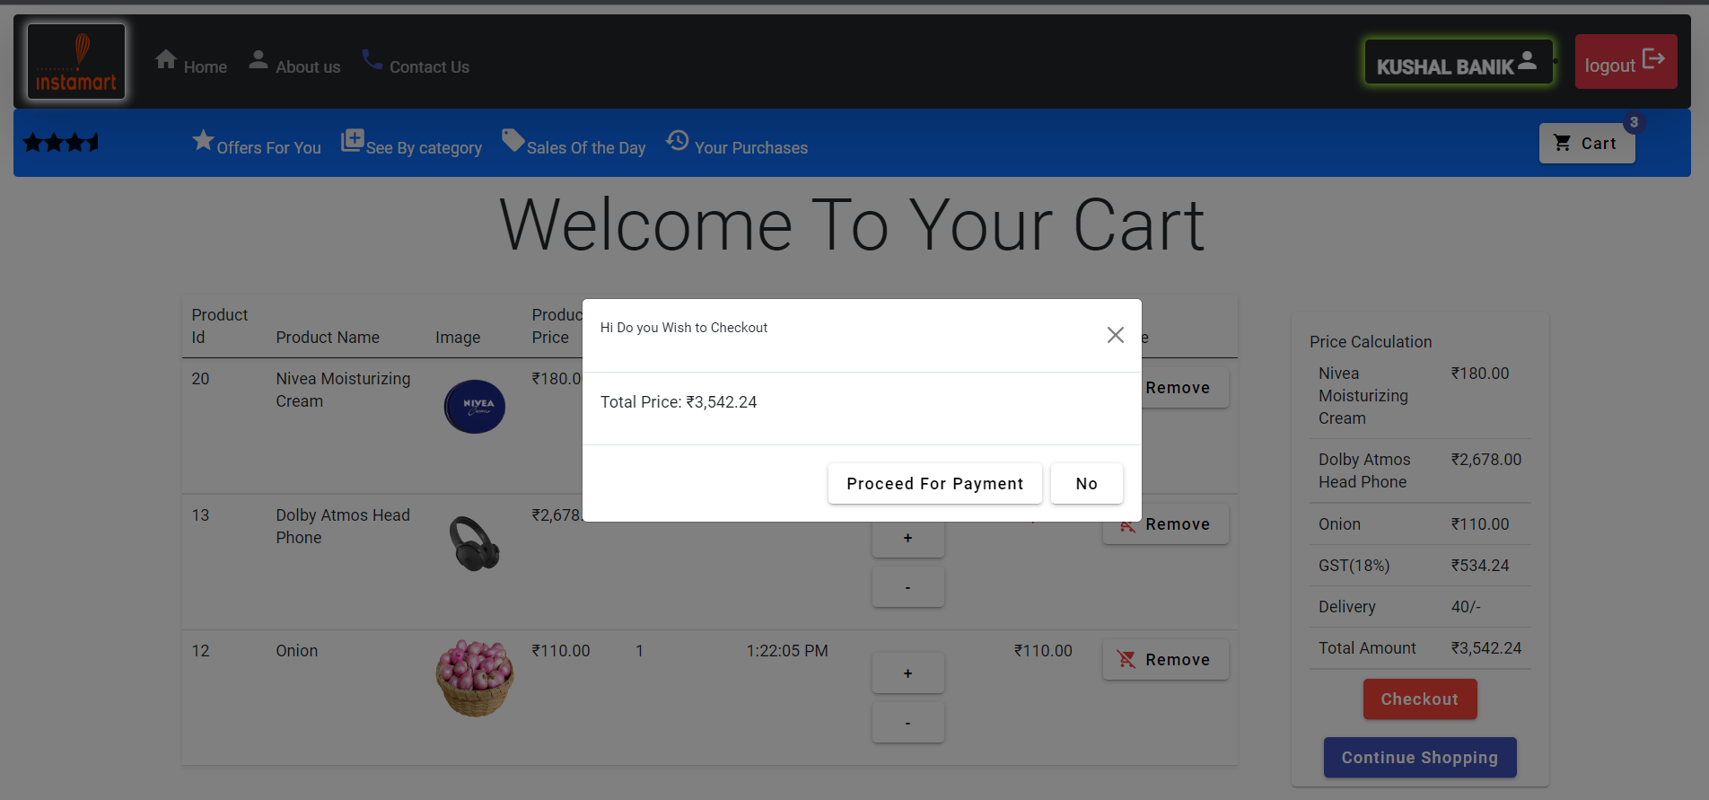
Cart Checkout Page

Slide 15
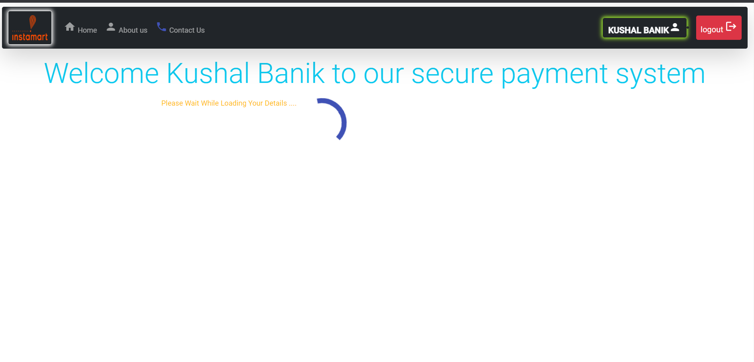
Payment Gateway Page

Slide 16
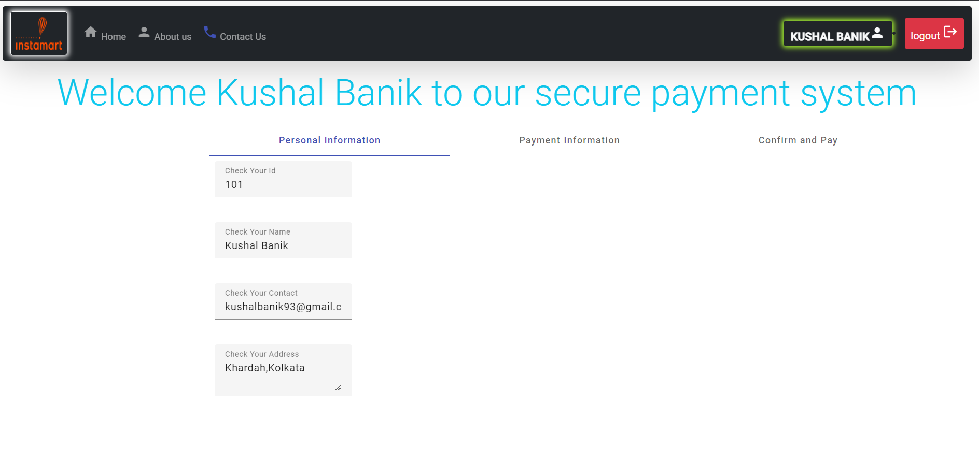
Payment Personal Details Page

Slide 17
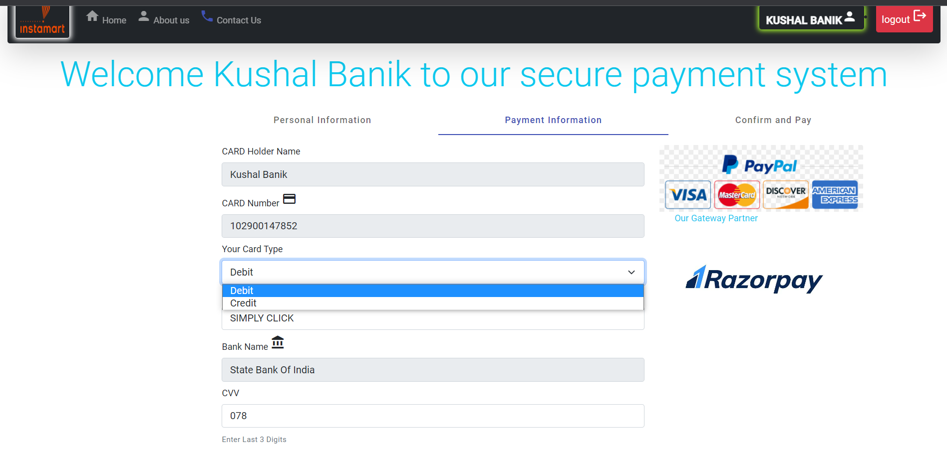
Card Info Payment Page

Slide 18

Confirm And Pay Page

Slide 19
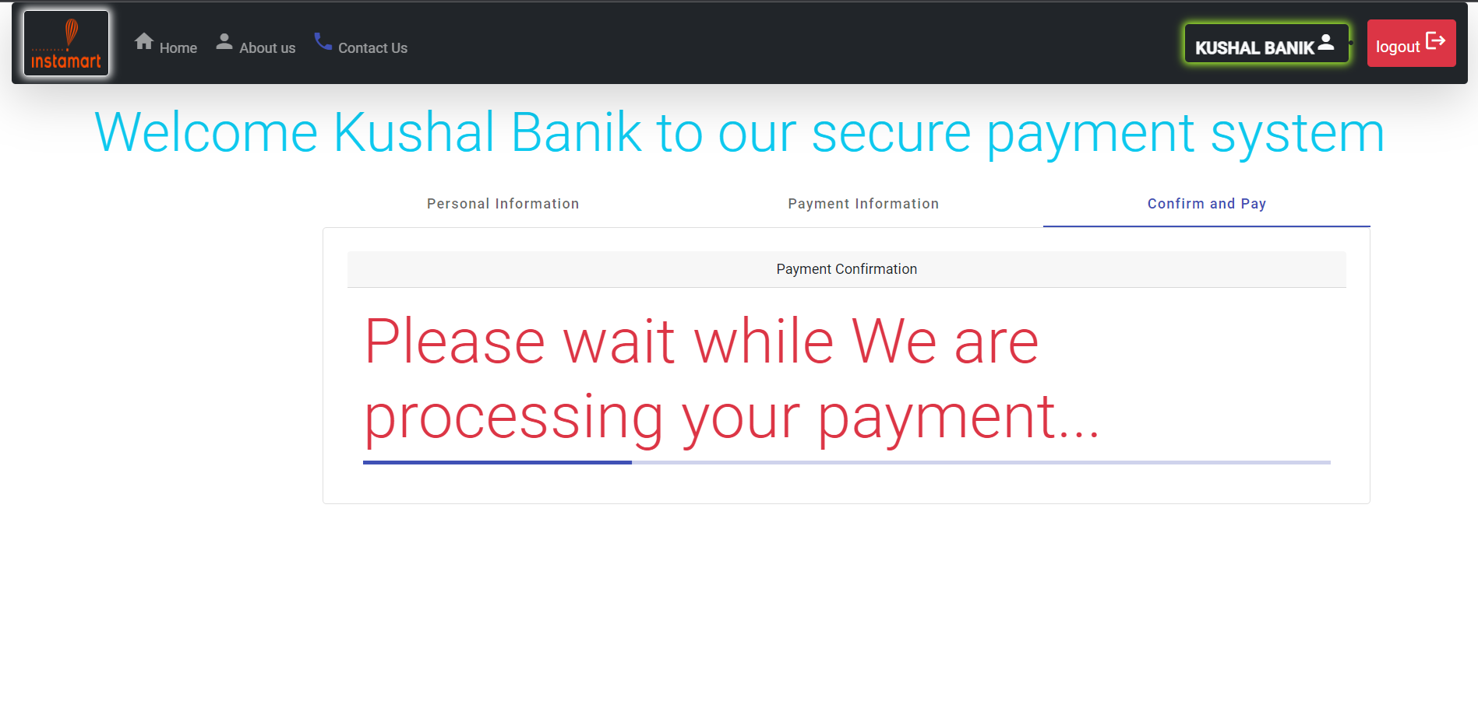
Payment Processing Page

Slide 20
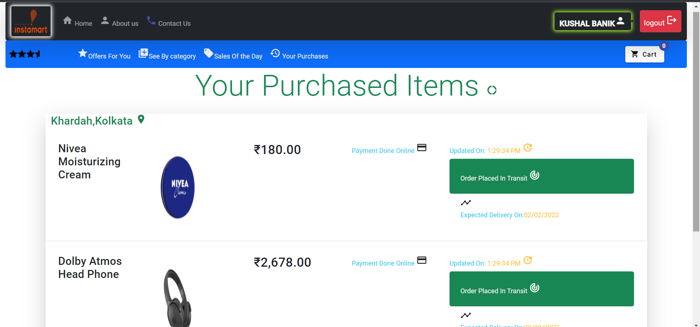
All Purchases Page

Slide 21

Home Page When Admin Logged In (1)

Slide 22
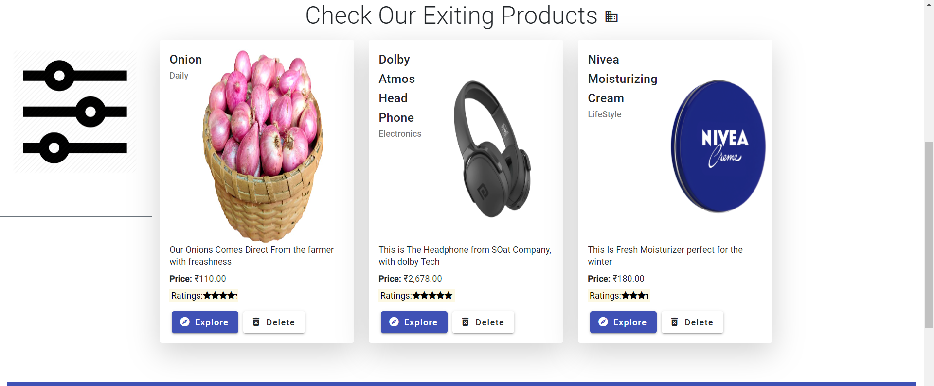
Home Page When Admin Logged In (2)

Slide 23
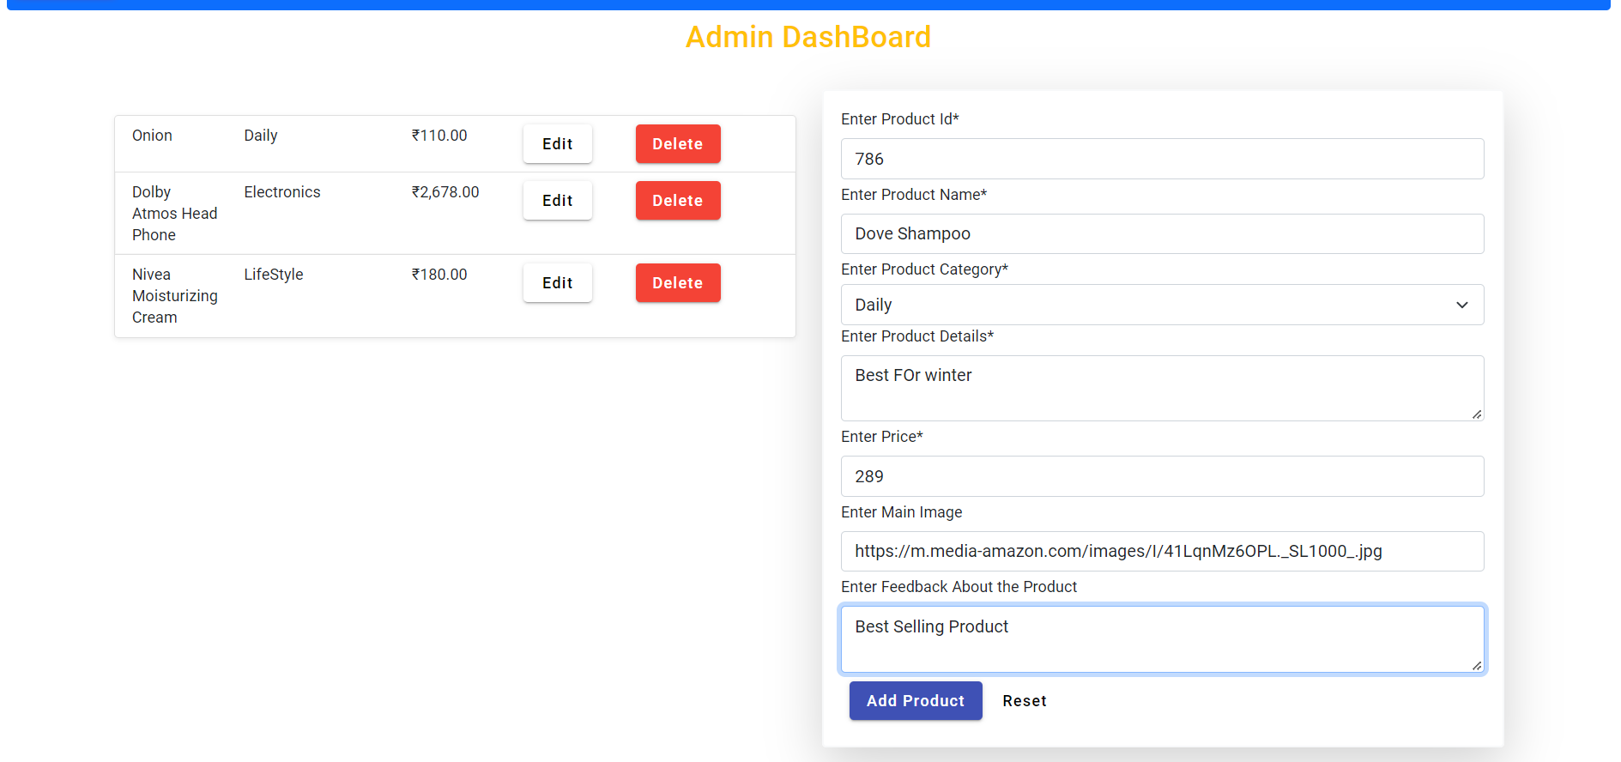
Admin Dash Board Adding a product

Slide 24
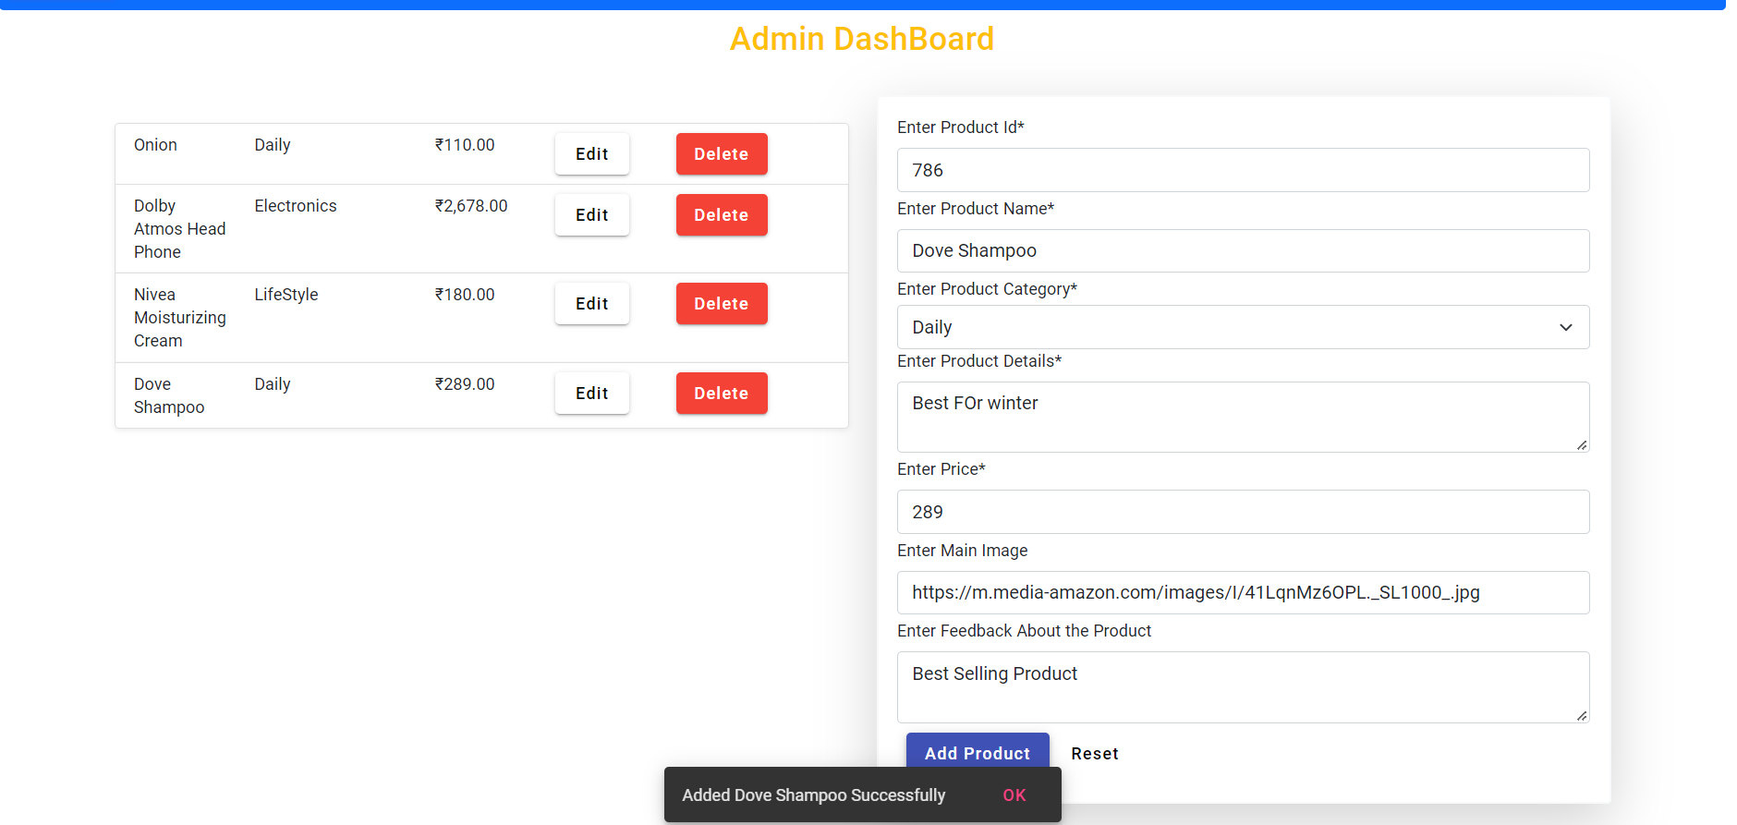
Admin Dash Board View For Added Product Successfully

Slide 25
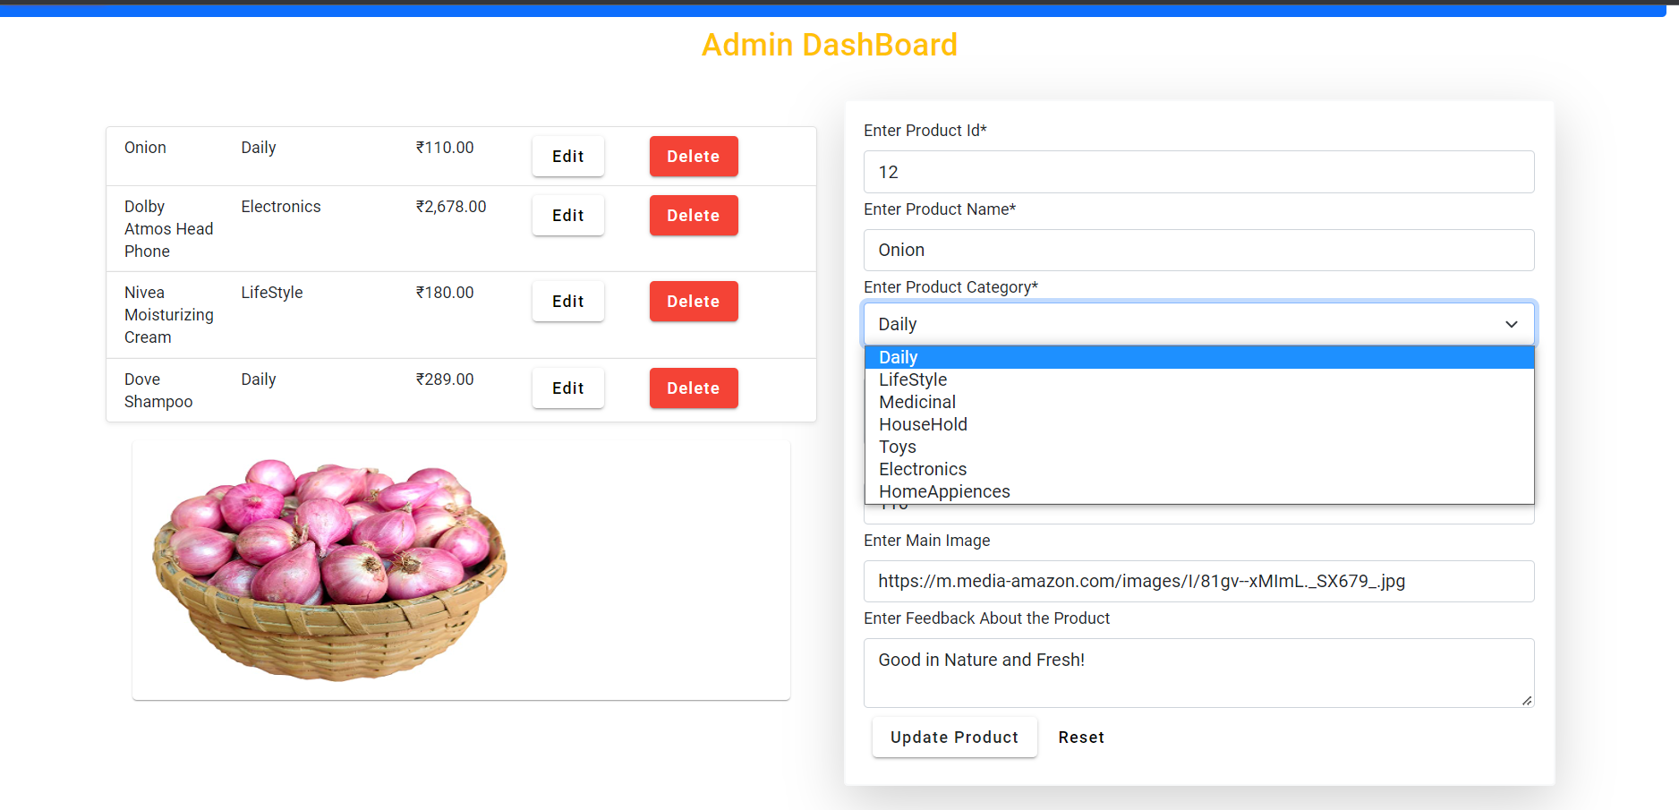
Product Updating from Admin Dash Board

Slide 26
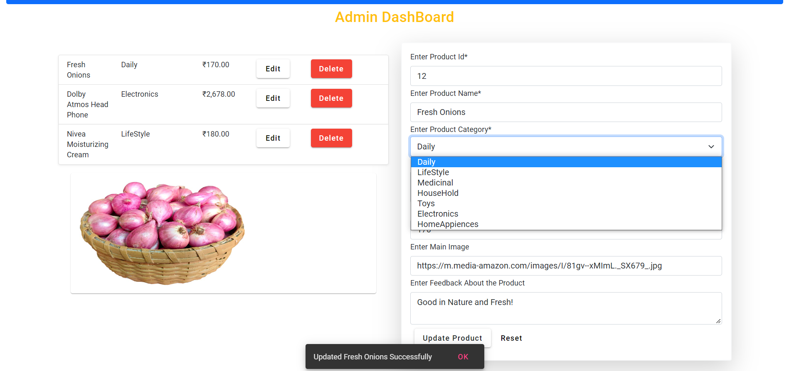
Product Updating Success From Admin Dash Board

Slide 27
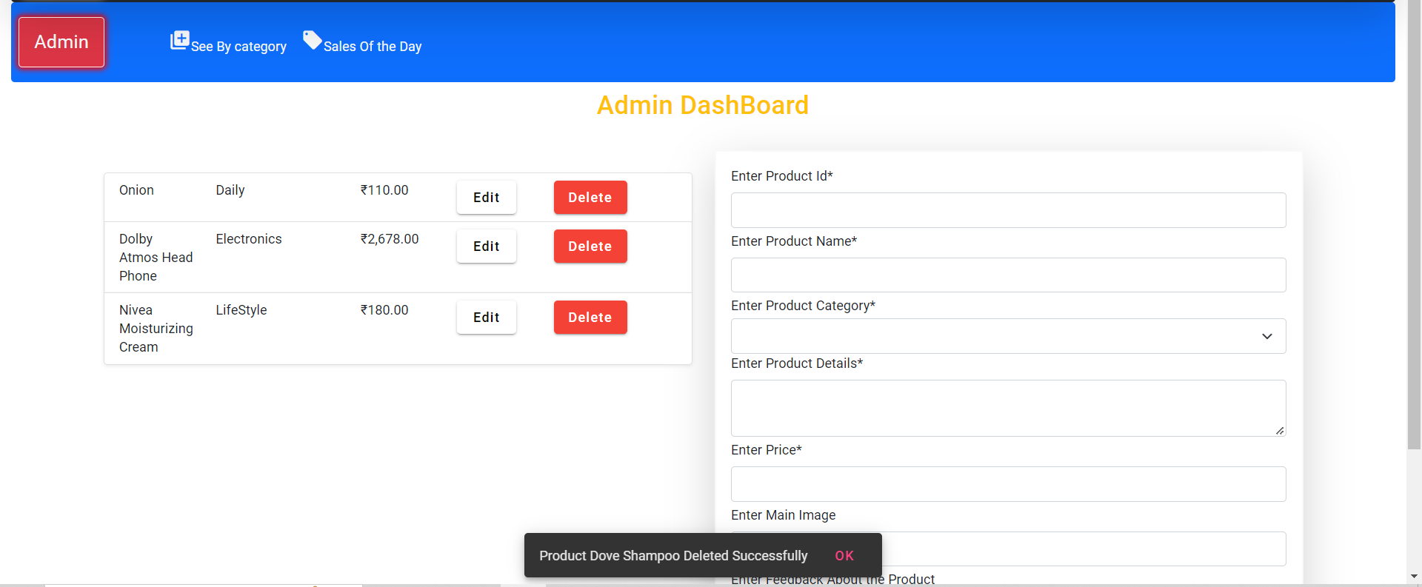
Product Deletion From Admin Dash Board

Slide 28
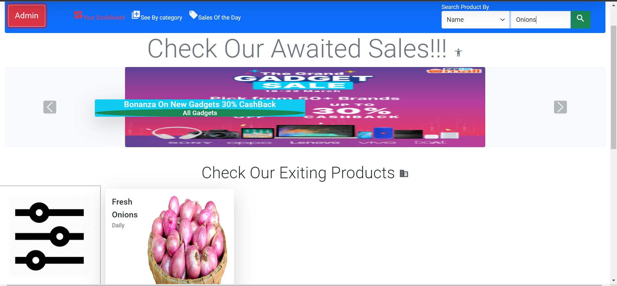
Product Search By Name

Slide 29
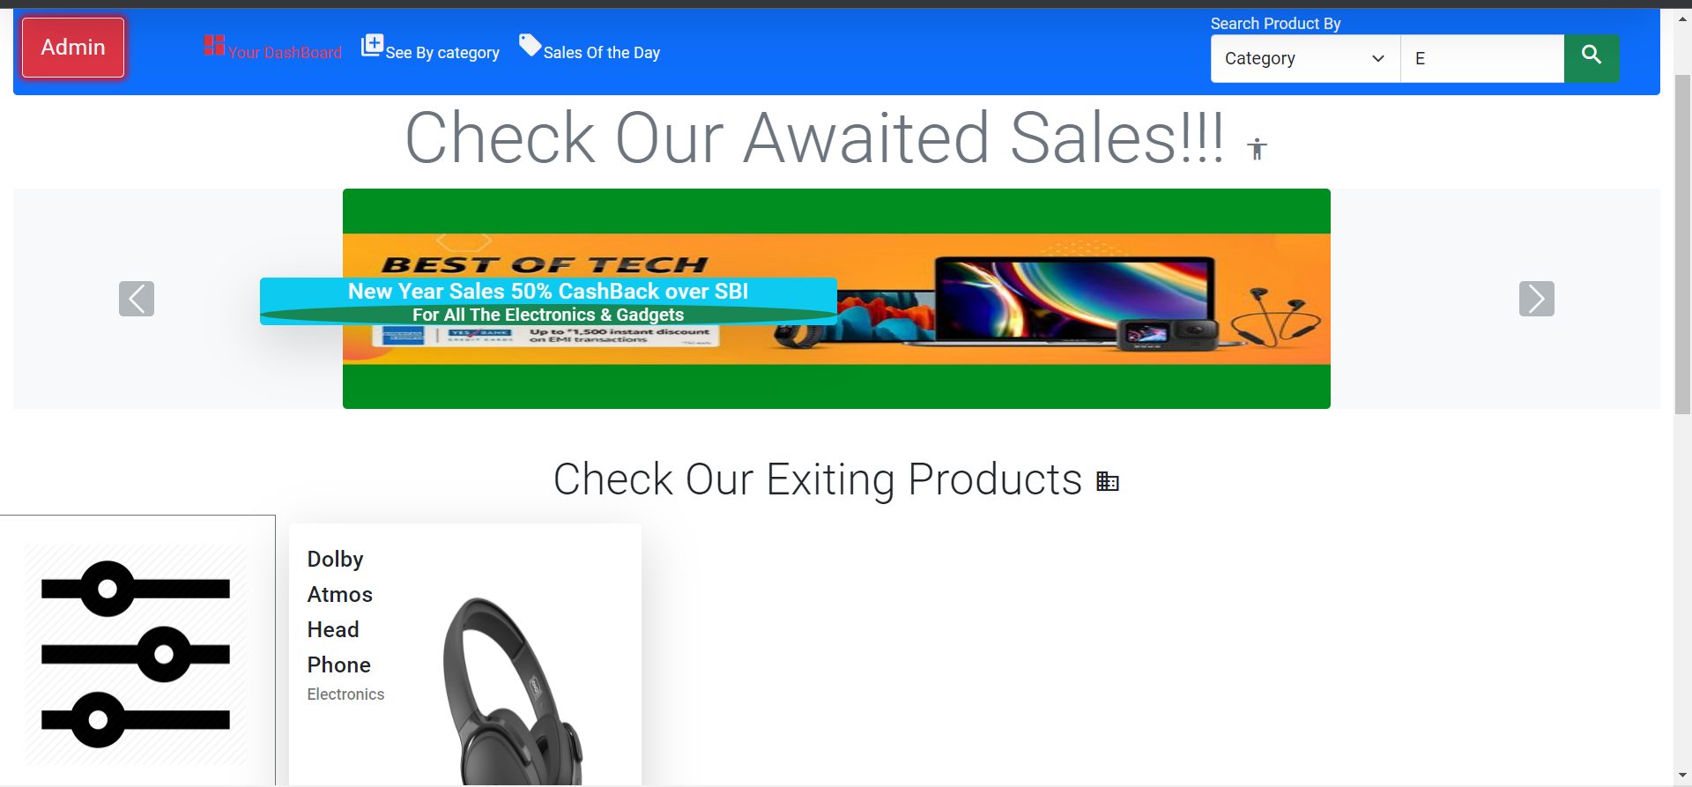
Search By Category

Slide 30
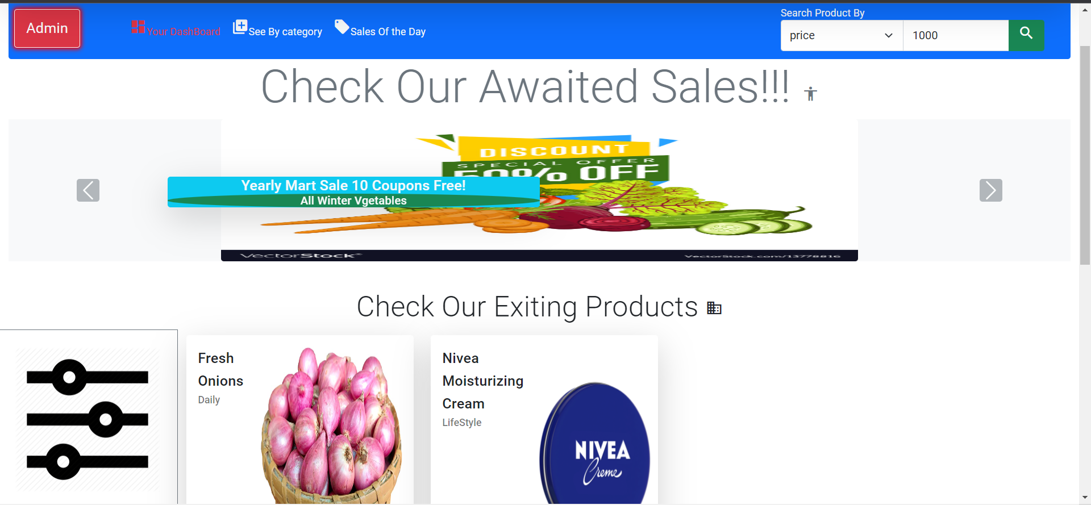
Search By Price Less Than Entered

Slide 31

About Us Page

Slide 32
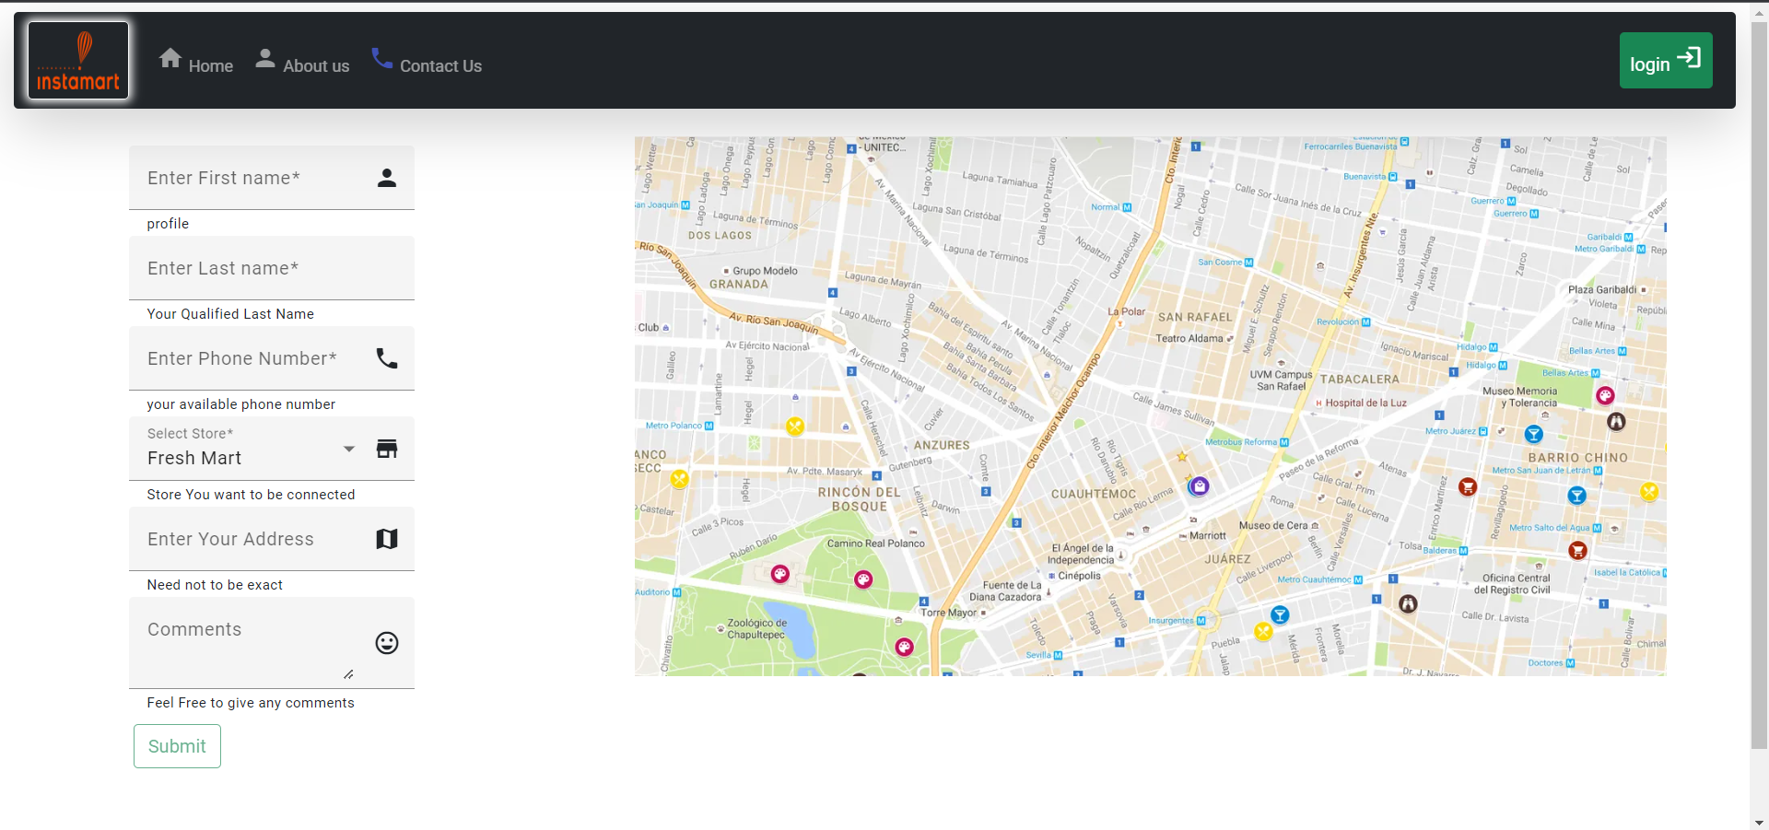
Contact Us Page

Slide 33
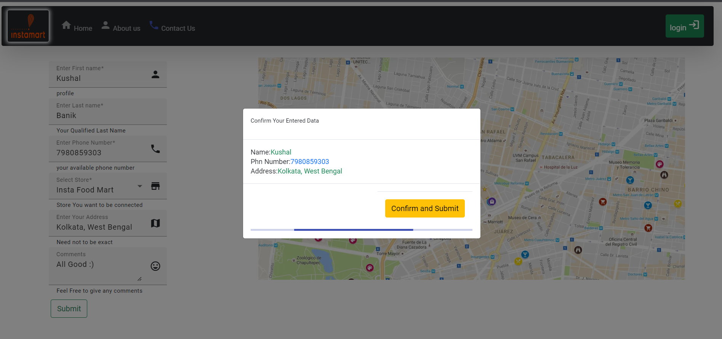
Contact Us Form Submission

Slide 34
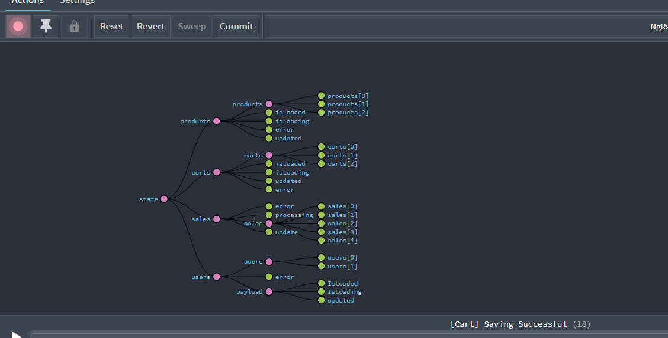
NGRX Tree With All the Redux Entities

Slide 35
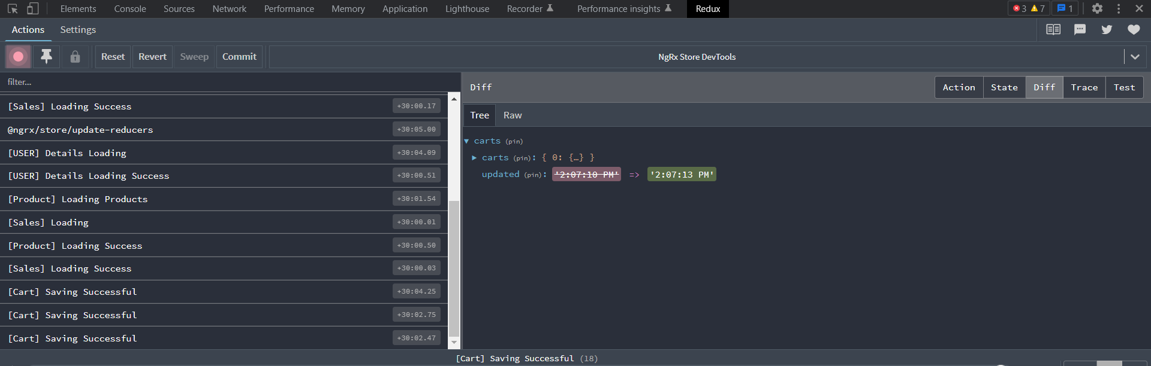
The Redux Inspector

Slide 36
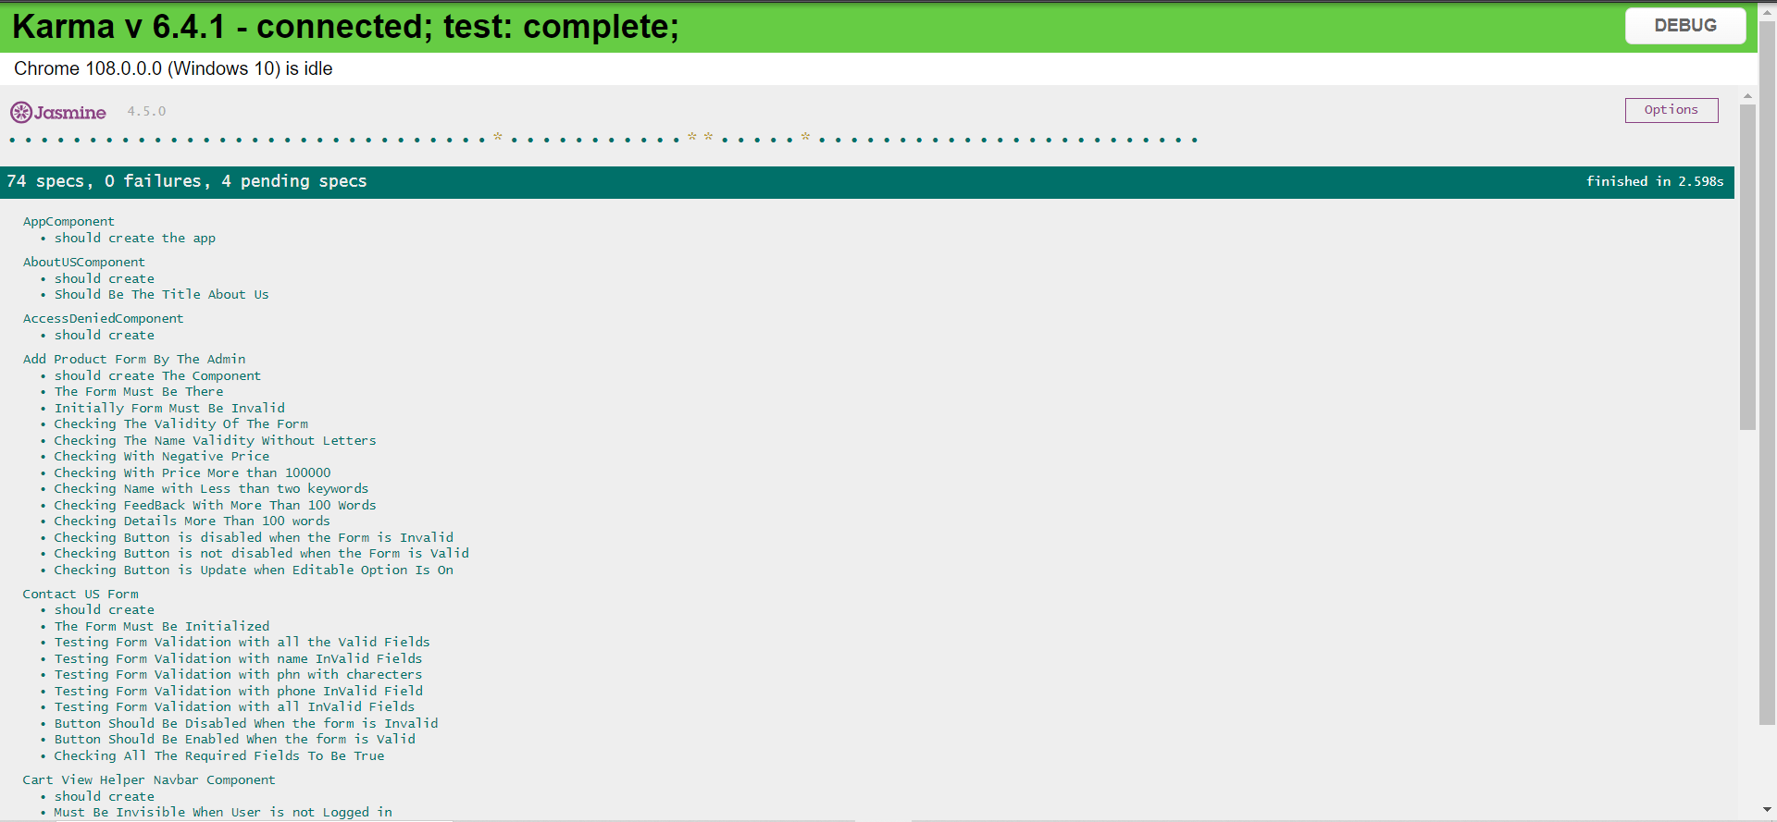
Jasmine Unit Test Cases, Total 70 Specs for Testing(1)

Slide 37
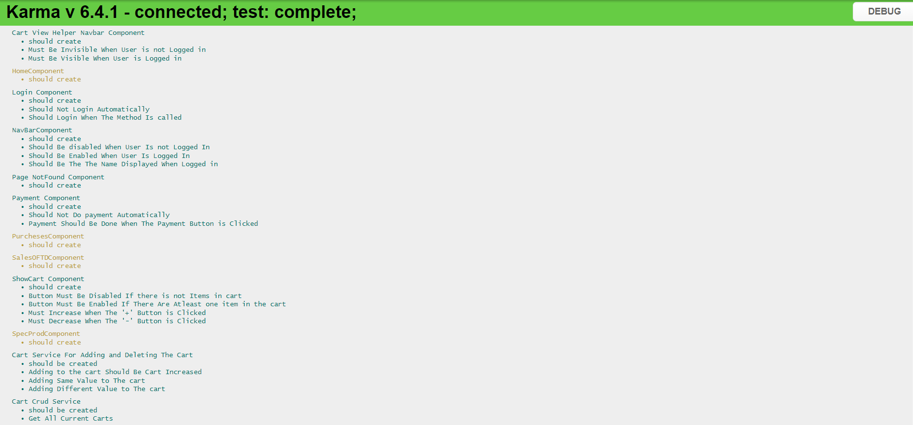
Jasmine Unit Test Cases, Total 70 Specs for Testing(2)

Slide 38
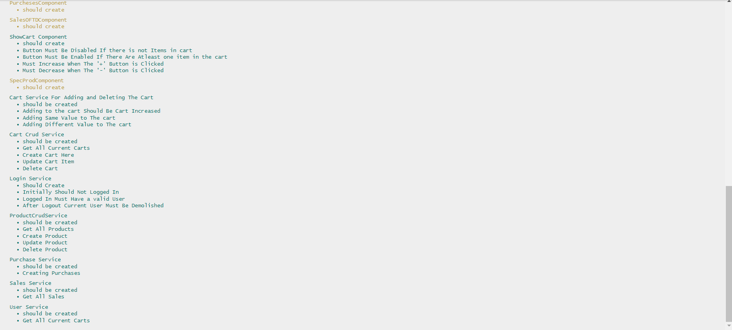
Jasmine Unit Test Cases, Total 70 Specs for Testing(3)

Slide 39


